Slide 1
Classification Using R

Slide 2
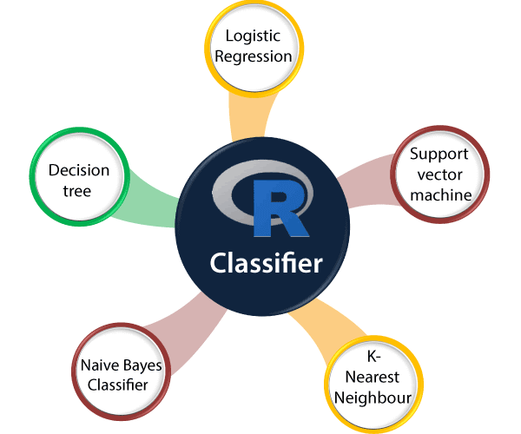
R Classification
Classifier It is an algorithm that maps the input data to a specific category.
Classification Model
A classification model tries to draw some conclusions from the input values which are given for training. This conclusion will predict class labels/categories for new data.
Feature It is an individual measurable property of an event being observed.
Binary classification It is a classification task that has two possible outcomes. E.g., Gender classification, which has only two possible outcomes, i.e., Male and Female.
Multi-class classification It is a classification task in which classification is done with more than two classes. An example of multi-class classification is: an animal can be a dog or cat, but not both at the same time.
Multi-label classification It is a classification task in which each sample is mapped with a set of target labels. An example of multi-label classification is: a news article that can be about a person, location, and sports at the same time.

Slide 3
Types of Classification Algorithms
Linear classifier: Logistic Regression, Naive Bayes classifier
Support vector machines
Decision Trees
Neural Networks
Learning vector quantization

Slide 4
Linear Classifier: Naive Bayes classifier
# Installing Packages
install.packages("e1071")
install.packages("caTools")
install.packages("caret")
# Loading package
library(e1071)
library(caTools)
library(caret)
# Splitting data into train # and test data
split <- sample.split(iris, SplitRatio = 0.7)
train_cl <- subset(iris, split == "TRUE")
test_cl <- subset(iris, split == "FALSE")
# Feature Scaling
train_scale <- scale(train_cl[, 1:4])
test_scale <- scale(test_cl[, 1:4])
# Fitting Naive Bayes Model
# to training dataset
set.seed(120) # Setting Seed
classifier_cl <- naiveBayes(Species ~ ., data = train_cl)
classifier_cl
# Predicting on test data'
y_pred <- predict(classifier_cl, newdata = test_cl)
# Confusion Matrix
cm <- table(test_cl$Species, y_pred)
cm
# Model Evaluation
confusionMatrix(cm)

Slide 5
SVM
# Fitting SVM
# to training dataset
library(e1071)
set.seed(120) # Setting Seed
classifier_cl <- svm(Species ~ ., data = train_cl, type=‘C-classification’, kernel=‘linear’)
classifier_cl
# Predicting on test data'
y_pred <- predict(classifier_cl, newdata = test_cl)
# Confusion Matrix
cm <- table(test_cl$Species, y_pred)
cm
# Model Evaluation
confusionMatrix(cm)

Slide 6
Decision Tree
# Fitting SVM
# to training dataset
library(rpart)
library(rpart.plot)
set.seed(120) # Setting Seed
classifier_cl <- rpart (Species ~ ., data = train_cl, method = 'class')
classifier_cl
# Predicting on test data'
y_pred <- predict(classifier_cl, newdata = test_cl)
# Confusion Matrix
cm <- table(test_cl$Species, y_pred)
cm
# Model Evaluation
confusionMatrix(cm)
rpart.plot(classifier_cl, extra = 106 )

Slide 7
KNN Classification
library(class)
library(ggplot2)
library(GGally)
iris_pred <- knn(train = iris.train[,1:4], test = iris.test[,1:4], cl = iris.train$Species, k=5)
table(iris.test$Species,iris_pred)
ggplot(data = iris, aes(x = Sepal.Length, y = Sepal.Width, col = Species)) + geom_point()
iris_pred <- knn(train = iris.train[,1:4], test = iris.test[,1:4], cl = iris.train$Species, k=5) table(iris.test$Species,iris_pred)

Slide 8
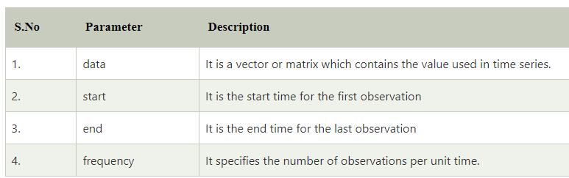
R-Time Series Analysis
R provides ts() function for creating a Time Series. There is the following syntax of the ts() function:
imeseries_object_name<- ts(data, start, end, frequency)
# Getting the data points in form of a R vector.
snowfall <- c(790,1170.8,860.1,1330.6,630.4,911.5,683.5,996.6,783.2,982,881.8,1021)
# Convertting it into a time series object.
snowfall_timeseries<- ts(snowfall,start = c(2013,1),frequency = 12)
# Printing the timeseries data.
print(snowfall_timeseries)
# Giving a name to the chart file.
png(file = "snowfall.png")
# Plotting a graph of the time series.
plot(snowfall_timeseries)
# Saving the file.
dev.off()

Slide 9
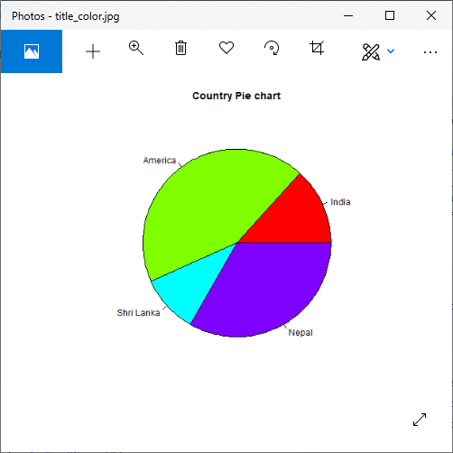
R Pie Charts
pie(X, Labels, Radius, Main, Col, Clockwise)
# Creating data for the graph.
x <- c(20, 65, 15, 50)
labels <- c("India", "America", "Shri Lanka", "Nepal")
# Giving the chart file a name.
png(file = "title_color.jpg")
# Plotting the chart.
pie(x,labels,main="Country Pie chart",col=rainbow(length(x)))
# Saving the file.
dev.off()
X is a vector that contains the numeric values used in the pie chart.
Labels are used to give the description to the slices.
Radius describes the radius of the pie chart.
Main describes the title of the chart.
Col defines the color palette.
Clockwise is a logical value that indicates the clockwise or anti-clockwise direction in which slices are drawn.

Slide 10

Pi-chart
# Creating data for the graph.
x <- c(20, 65, 15, 50)
labels <- c("India", "America", "Shri Lanka", "Nepal")
pie_percent<- round(100*x/sum(x), 1)
# Giving the chart file a name.
png(file = "per_pie.jpg")
# Plotting the chart.
pie(x, labels = pie_percent, main = "Country Pie Chart",col = rainbow(length(x)))
legend("topright", c("India", "America", "Shri Lanka", "Nepal"), cex = 0.8,
fill = rainbow(length(x)))
#Saving the file.
dev.off()

Slide 11
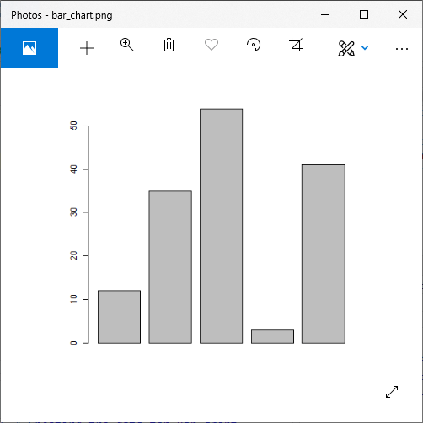
R Bar Charts
# Creating the data for Bar chart
H<- c(12,35,54,3,41)
# Giving the chart file a name
png(file = "bar_chart.png")
# Plotting the bar chart
barplot(H)
# Saving the file
dev.off()

Slide 12
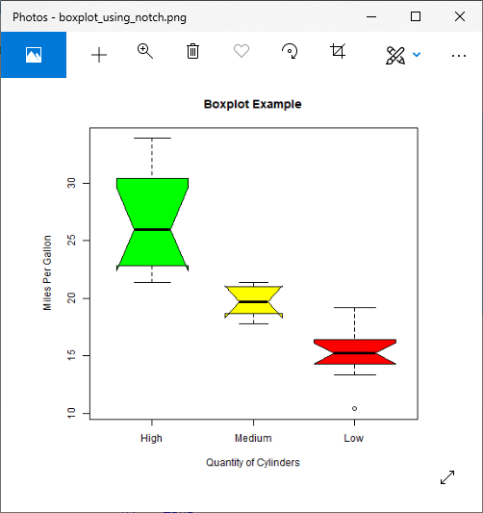
R- Box Plot
# Giving a name to our chart.
png(file = "boxplot_using_notch.png")
# Plotting the chart.
boxplot(mpg ~ cyl, data = mtcars,
xlab = "Quantity of Cylinders",
ylab = "Miles Per Gallon",
main = "Boxplot Example",
notch = TRUE,
varwidth = TRUE,
ccol = c("green","yellow","red"),
names = c("High","Medium","Low")
)
# Saving the file.
dev.off()

Slide 13
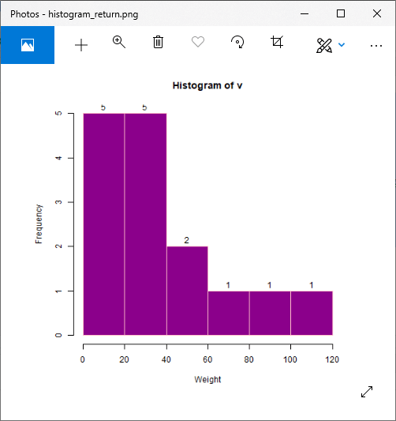
R Histogram
hist(v,main,xlab,ylab,xlim,ylim,breaks,col,border)
# Creating data for the graph.
v <- c(12,24,16,38,21,13,55,17,39,10,60,120,40,70,90)
# Giving a name to the chart file.
png(file = "histogram_return.png")
# Creating the histogram.
m<-hist(v,xlab = "Weight",ylab="Frequency",col = "darkmagenta",border = "pink", breaks = 5)
#Setting labels
text(m$mids,m$counts,labels=m$counts, adj=c(0.5, -0.5))
# Saving the file.
dev.off()

Slide 14
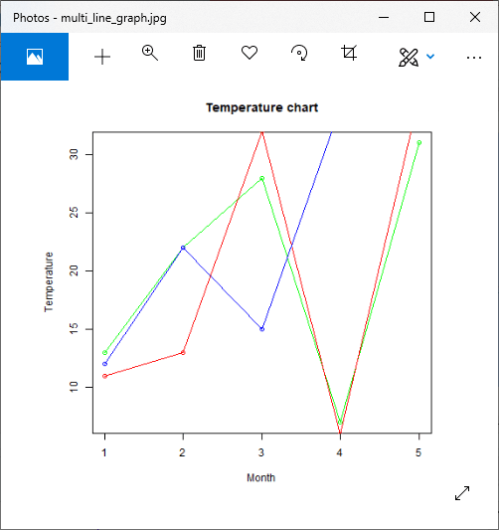
R Line Graphs
# Creating the data for the chart.
v <- c(13,22,28,7,31)
w <- c(11,13,32,6,35)
x <- c(12,22,15,34,35)
# Giving a name to the chart file.
png(file = "multi_line_graph.jpg")
# Plotting the bar chart.
plot(v,type = "o",col="green",xlab="Month",ylab="Temperature")
lines(w, type = "o", col = "red")
lines(x, type = "o", col = "blue")
# Saving the file.
dev.off()

Slide 15
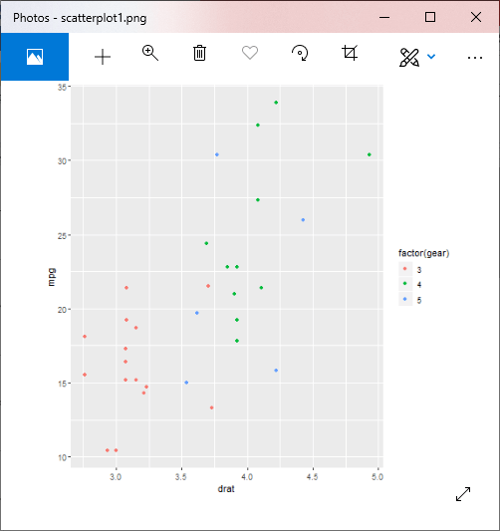
R Scatterplots
plot(x, y, main, xlab, ylab, xlim, ylim, axes)
#Loading ggplot2 package
library(ggplot2)
# Giving a name to the chart file.
png(file = "scatterplot1.png")
# Plotting the chart using ggplot() and geom_point() functions.
#The aes() function inside the geom_point() function controls the color of the group.
ggplot(mtcars, aes(x = drat, y = mpg)) +
geom_point(aes(color=factor(gear)))
# Saving the file.
dev.off()

Slide 16
iris_pred <- knn(train = iris.train[,1:4], test = iris.test[,1:4], cl = iris.train$Species, k=5) table(iris.test$Species,iris_pred)

